Slide 1
Chapter 1-3
SECTION 1.2 REVIEW
Fundamentals of Marketing
- click twice to continue -

Slide 2
Fundamentals of Marketing
Objectives
Describe the Components of the marketing mix
Test:
Create a New Product
apply the 4 Ps of marketing
create a customer profile
Note: Try to memorize the terms in this section, because you will use them throughout your study of marketing!
Marketing Essentials Chapter 1, Section 1.3

Slide 3
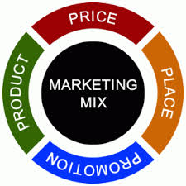
Marketing Mix
The marketing mix X includes four basic marketing strategies, or tools, called the four Ps that is used to influence buying decisions of a target market
product
price
promotion
place

Slide 4
Marketing Mix
Actions & decisions in the 4 Ps are based on the people marketers want to win over
What do we as marketers call those with similar wants and needs that may buy the product??
The Target market
Target Market

Slide 5

Marketing Mix
Video: Go to Google Classroom and complete the EdPuzzle on the 4Ps of Marketing. You can also click this link and watch it before answering the questions. But Edpuzzle is required with each question worth 2 points for a total of 32 points.
Marketing Essentials Chapter 1, Section 1.3

Slide 6
Product
Product: Any reason/feature that makes people want the product (good or service)
Much goes into Product design:
Variety
Quality
Design
Package
Brand
Features – size of screen, color, material
Service - ie: two yr free inspection on a new car
Warranty – ie.e money back guarantee, # of years replacement

Slide 7
Price
Price: what is the value of product/service to the customer in terms of money.
1. Consider what competition is charging when creating a price
2. Industrial market Pricing= Wholesale Price
Establish a wholesale price for the retailer
Create a suggested retail price
Business discount pricing
Example, if you buy 24 @ $29.00 or 48 @ $22.00 each
Establish credit terms and payment terms
Example: 30 days to pay at no interest, after that you pay interest/late fees.

Slide 8
Price
Price: what is the value of the product/service to the customer in terms of money.
3. Consumer pricing = Retail Pricing
Retail price = amount paid by consumers
Bonus (get additional items with your purchase)
Consumer discounts - $$$ off, sale
Free Shipping – 1 & 2 day for different pricing
Payment Options/Plans – layaway plans
Marketing Essentials Chapter 1, Section 1.3

Slide 9
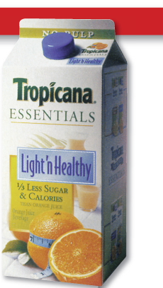
dkfjaldsfj
Directions: List Product and Price on a line on the chart. List at least four answers to what decisions that were probably made about each.
Product
Price
$3.99
Wholesale price 50% less than retail
Free to pick up in stores curbside Orders subject to $14.99 Same Day Delivery fee

Slide 10
Place
Place: decisions outline where a company sells a product and how it delivers the product to the market.
Where to sell:
Sell in retail stores, online, catalogs or vending machines
Who to sell too – direct to consumers, businesses, both
Sell Internationally, locally, or on internet
Distribution:
Delivery options –pick up in store, delivered to door, download, curbside
How did it get to retail store - distribution method to use (warehouse, air, ship, rail)
Logistics = stock levels –
how much on hand how quickly can it be delivered

Slide 11
Promotion
Promotion: Where, when and how you deliver your marketing messages to your target market (how you tell them about your products) Includes:
Advertising
Selling and sales calls – face to face/door to door
Sales events (announcement of)
Special offers (buy one get one free)
Public Relations – news releases, community service
Sponsorships and endorsements
Brochures
Timing of promotional campaigns

Slide 12
dkfjaldsfj
Directions: Label the remaining lines below with Promotion and Place. List at least four answer to what decisions were made about each.
$3.99
Promotion
Place
Wholesale price 50% less than retail
Free to pick up in stores curbside Orders subject to $14.99 Same Day Delivery fee

Slide 13

dkfjaldsfj
Who is the Primary Target Market?
Is there a Secondary Market?
$3.99
Wholesale price 50% less than retail
Free to pick up in stores curbside Orders subject to $14.99 Same Day Delivery fee

Slide 14
dkfjaldsfj
Name:
Directions: Work with a partner. Label each line below with one of the 4Ps of marketing – Go to Tesla.com. Review their Web page and try to find at least:
Product: 5 items about product that make people want them
Place: 3 details about place (where they have stores, where can buy, and where to charge). Price and Promotion. List at least 3 of each. For promotion, find at least one ad, and print it, attach to this item, and hand in.

